Slide 1
Corpus Linguistics
2023-11-17
Adam J.R. Tallman
Corpus Queries

Slide 2
Concepts for today
Software for corpus queries
Programming languages
Frequency lists
Keywords
Frequency plot
Dispersion plot
Zipfian distribution and Zipf’s law
Collocations / Bigram frequencies
Association measures
Colligation
Regular expressions
Sketch Engine

Slide 3
Software for corpus queries
There are special softwares & web interfaces for corpora
You can make tables and export them, and search data etc.
ELAN: a program for transcribing and translating texts
FLEx: a program that allows for interlinear glossing
Sketch Engine: a web interface that allows a number of basic query options

Slide 4
SketchEngine
Go online and enter SketchEngine
https://www.sketchengine.eu/

Slide 5
Programming languages
There are also programming languages that can search corpora – these are more general and flexible
Python
R

Slide 6
Download R & R Studio
R and R Studio
https://cran.r-project.org
https://www.rstudio.com/products/RStudio/

Slide 7
Four basic tools
Frequency lists
Dispersion information (and dispersion plots)
Collocations
Concordances

Slide 8
Frequency lists
Frequency table displays how often something (some words) occur
Token frequency: count of all instances of some form
Type frequency: count of all unique types

Slide 9
Frequency lists
Let’s make a frequency list
Search for adverbs that begin with ‘q’ (token frequency)
Search for part of speech frequency (type frequency)

Slide 10
Please download Libraoffice
https://www.libreoffice.org/download/download-libreoffice/

Slide 11
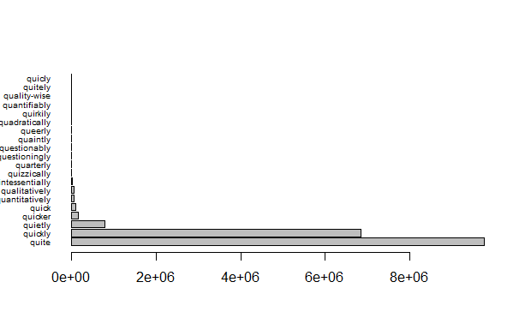
Frequency plot (raw)

Slide 12
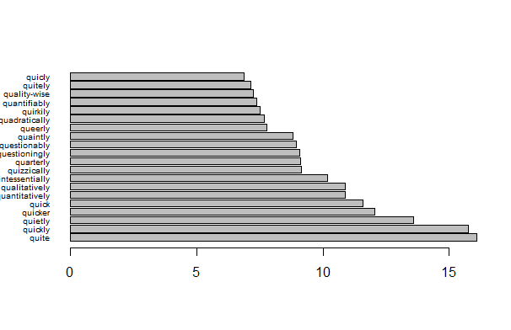
Frequency plot (log)

Slide 13
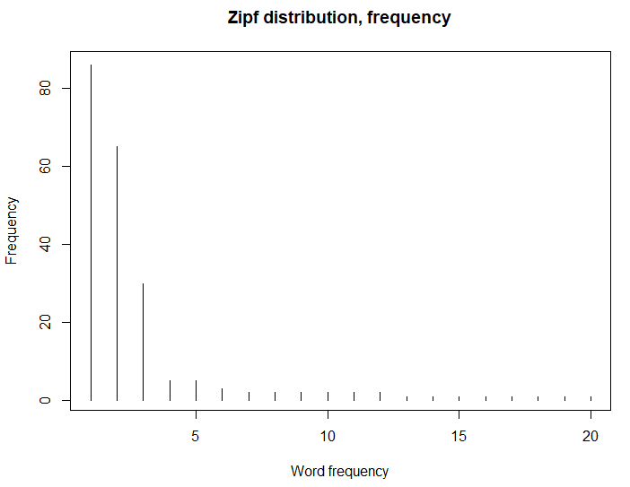
Zipf’s law
Corpus frequency in a corpus of any token is inversely proportional to its rank in the list of the most frequent words

Slide 14
Keywords
In corpus linguistics, keywords are things that are really frequent in a given part of a corpus compared to other parts.
For instance, if you Wikipedia https://en.wikipedia.org/wiki/Germany
‘Berlin’ or ‘Germany’ could be considered keywords as these are more frequent than in other Wikipedia articles

Slide 15
Keywords
Let’s look at the Keywords for Donald Trump Rally

Slide 16
Dispersion
Words that have the same frequency can have different distributions
Very frequent words are typically distributed evenly
But other words can have uneven distributions, ‘clumping’ around particular areas of a text

Slide 17
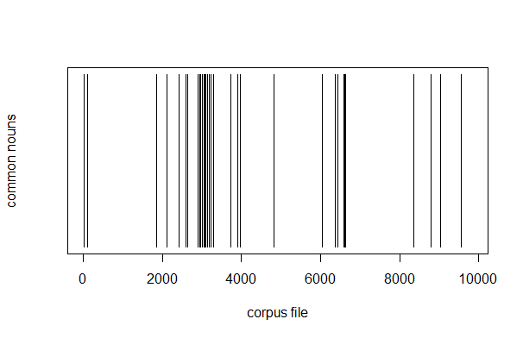
Dispersion plot

Slide 18
Collocations / Bigrams
Collocation: the probabilistic co-occurrence of word-forms such as different from vs. different to vs. different than, or the absolute frozenness of expressions such as kith and kin or by and large
Colligation: the co-occurrence of words with grammatical phenomena such as parts of speech, grammatical relations, or ‘definiteness’, such as the preference of consequence to occur as a completel and with indefinite articles
Gries 2016: 15

Slide 19
Collocations / Bigrams
Let’s look on sketch engine

Slide 20
Measures of association
Joint probability: Probability of the two words occurring together
Conditional probability (forward transitional probability): What is probability of having a certain word given that you’ve already seen one
MI: Words that often occur together and not apart

Slide 21
Joint probability
The pro

Slide 22
Conditional probability

Slide 23
MI

Slide 24
Entropy & Information

Slide 25
Sketch engine practice

